Slide 1




(SQL, PYTHON, POWERBI)
CAPSTONE
PROJECT

Slide 2
BUSINESS REQUIREMENT
To conduct a comprehensive analysis of Blinkit's sales performance, customer satisfaction, and inventory distribution to identify key insights and opportunities for optimization using various KPIs and visualizations in Power BI.
KPI’s Requirements
Total Sales: The overall revenue generated from all items sold.
Average Sales: The average revenue per sale.
Number of Items: The total count of different items sold.
Average Rating: The average customer rating for items sold.

Slide 3
Chart’s Requirements
1. Total Sales by Fat Content:
Objective: Analyze the impact of fat content on total sales.
Additional KPI Metrics: Assess how other KPIs (Average Sales, Number of Items, Average Rating) vary with fat content. Chart Type: Donut Chart.
2. Total Sales by Item Type:
Objective: Identify the performance of different item types in terms of total sales.
Additional KPI Metrics: Assess how other KPIs (Average Sales, Number of Items, Average Rating) vary with fat content. Chart Type: Bar Chart.
3. Fat Content by Outlet for Total Sales:
Objective: Compare total sales across different outlets segmented by fat content.
Additional KPI Metrics: Assess how other KPIs (Average Sales, Number of Items, Average Rating) vary with fat content. Chart Type: Stacked Column Chart.

Slide 4
Chart’s Requirements
4. Total Sales by Outlet Establishment:
Objective: Evaluate how the age or type of outlet establishment influences total sales.
Chart Type: Line Chart.\
5. Sales by Outlet Size:
Objective: Analyze the correlation between outlet size and total sales.
Chart Type: Donut/ Pie Chart.
6. Sales by Outlet Location:
Objective: Assess the geographic distribution of sales across different locations.
Chart Type: Funnel Map.

Slide 5
PDF File of Python Data Analysis

Slide 6
Blinkit Analysis
Using Power BI

Slide 7
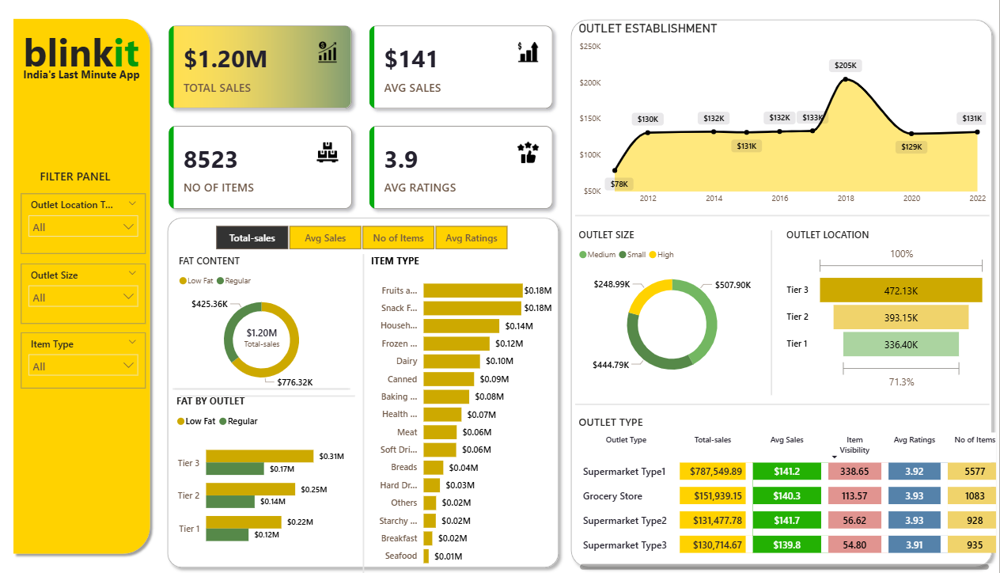

Slide 8
blinkit Dashboard Powerbi

Slide 9
blinkit Analysis
See all the data imported:
SELECT * FROM blinkit_data
DATA CLEANING:
Cleaning the Item_Fat_Content field ensures data consistency and accuracy in analysis. The presence of multiple variations of the same category (e.g., LF, low fat vs. Low Fat) can cause issues in reporting, aggregations, and filtering. By standardizing these values, we improve data quality, making it easier to generate insights and maintain uniformity in our datasets.
UPDATE blinkit_data
SET Item_Fat_Content =
CASE
WHEN Item_Fat_Content IN ('LF', 'low fat') THEN 'Low Fat'
WHEN Item_Fat_Content = 'reg' THEN 'Regular'
ELSE Item_Fat_Content
END;

Slide 10

blinkit Analysis
After executing this query check the data has been cleaned or not using below query
SELECT DISTINCT Item_Fat_Content FROM blinkit_data;

Slide 11

blinkit Analysis
A. KPI’s
1. TOTAL SALES:
SELECT CAST(SUM(Total_Sales) / 1000000.0 AS DECIMAL(10,2)) AS Total_Sales_Million
FROM blinkit_data;

Slide 12

blinkit Analysis
2. AVERAGE SALES
SELECT CAST(AVG(Total_Sales) AS INT) AS Avg_Sales
FROM blinkit_data;

Slide 13

blinkit Analysis
3. NO OF ITEMS
SELECT COUNT(*) AS No_of_Orders
FROM blinkit_data;

Slide 14

blinkit Analysis
4. AVG RATING
SELECT CAST(AVG(Rating) AS DECIMAL(10,1)) AS Avg_Rating
FROM blinkit_data;

Slide 15

blinkit Analysis
B. Total Sales by Fat Content:
SELECT Item_Fat_Content, CAST(SUM(Total_Sales) AS DECIMAL(10,2)) AS Total_Sales
FROM blinkit_data
GROUP BY Item_Fat_Content

Slide 16
blinkit Analysis
C. Total Sales by Item Type
SELECT Item_Type, CAST(SUM(Total_Sales) AS DECIMAL(10,2)) AS Total_Sales
FROM blinkit_data
GROUP BY Item_Type
ORDER BY Total_Sales DESC

Slide 17
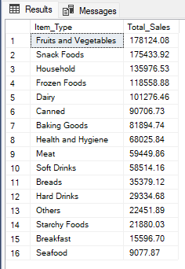
blinkit Analysis

Slide 18
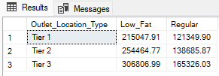
D. Fat Content by Outlet for Total Sales
SELECT Outlet_Location_Type,
ISNULL([Low Fat], 0) AS Low_Fat,
ISNULL([Regular], 0) AS Regular
FROM
( SELECT Outlet_Location_Type, Item_Fat_Content,
CAST(SUM(Total_Sales) AS DECIMAL(10,2)) AS Total_Sales FROM blinkit_data
GROUP BY Outlet_Location_Type, Item_Fat_Content ) AS SourceTable
PIVOT
( SUM(Total_Sales)
FOR Item_Fat_Content IN ([Low Fat], [Regular])
) AS PivotTable
ORDER BY Outlet_Location_Type;

Slide 19
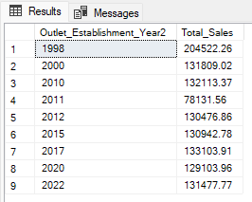
blinkit Analysis
E. Total Sales by Outlet Establishment
SELECT Outlet_Establishment_Year, CAST(SUM(Total_Sales)
AS DECIMAL(10,2)) AS Total_Sales
FROM blinkit_data
GROUP BY Outlet_Establishment_Year
ORDER BY Outlet_Establishment_Year

Slide 20
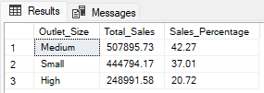
blinkit Analysis
F. Percentage of Sales by Outlet Size
SELECT
Outlet_Size,
CAST(SUM(Total_Sales) AS DECIMAL(10,2)) AS Total_Sales,
CAST((SUM(Total_Sales) * 100.0 / SUM(SUM(Total_Sales)) OVER()) AS DECIMAL(10,2)) AS Sales_Percentage
FROM blinkit_data
GROUP BY Outlet_Size
ORDER BY Total_Sales DESC;

Slide 21
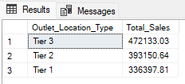
blinkit Analysis
G. Sales by Outlet Location
SELECT Outlet_Location_Type, CAST(SUM(Total_Sales) AS DECIMAL(10,2)) AS Total_Sales
FROM blinkit_data
GROUP BY Outlet_Location_Type
ORDER BY Total_Sales DESC

Slide 22
H. All Metrics by Outlet Type:
SELECT Outlet_Type,
CAST(SUM(Total_Sales) AS DECIMAL(10,2)) AS Total_Sales,
CAST(AVG(Total_Sales) AS DECIMAL(10,0)) AS Avg_Sales,
COUNT(*) AS No_Of_Items,
CAST(AVG(Rating) AS DECIMAL(10,2)) AS Avg_Rating,
CAST(AVG(Item_Visibility) AS DECIMAL(10,2)) AS Item_Visibility
FROM blinkit_data
GROUP BY Outlet_Type
ORDER BY Total_Sales DESC

Slide 23
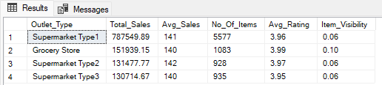
blinkit Analysis

Slide 24
Thankyou

